Slide 1
‘Just’ the flu...?

Slide 2

The flu kills 11,000 people on average every year and many more people need hospital care.
There’s no just about it.

Slide 3






The flu virus spreads from person to person and some people won’t show symptoms.

Slide 4




Some people are more likely to develop potentially serious complications of flu, such as pneumonia
(a lung infection):
Children and adults with an underlying or long term health condition
Pregnant women
Anyone aged 65 and over

Slide 5
It’s recommended that people more at risk have a flu vaccine every year to help protect them.

Slide 6
This year the NHS is offering the free flu jab to:
adults aged 65 and over
adults and children with certain medical conditions
pregnant women
people living with someone who's at high risk from coronavirus, on the NHS shielded patient list
children
    aged 2 and 3
    children in primary school
    children in year 7 (secondary school)

Slide 7

Getting your free flu jab
Your GP practice will contact you by letter or text to book in.
Invites are from the end of September throughout the flu season. You can Contact your GP to find out when you will receive it.
You can book an appointment at your local pharmacy if you’re over 18.

Slide 8

Questions and answers…...

Slide 9

Will the flu jab protect me against Covid-19? No just the flu.
How will I know if I have flu or Covid? Both have similar symptoms so it may be difficult to tell. For this reason, it’s really important that you have your vaccination if you are eligible.
Is the vaccine stronger this year? No, this year’s vaccine has been designed to target this season’s strain of flu, as with every year.

Slide 10


Where will I have the jab?
Your GP practice, health centre or pharmacy, details will be in your invite.
Is the flu vaccination safe?
Flu vaccine is the best protection we have against this virus and studies have shown that it does help to prevent flu.
Are there side effects?
Possibly a mild temperature, sore arm or slight muscle aches for a day or so. This is entirely normal. Serious allergic reactions are rare.

Slide 11

Is gelatine used in the flu vacine?
The nasal spray vaccine that protects children against flu contains porcine gelatin. This is offered to children as it is more effective than the injected vaccine.
Why?
Porcine gelatine is used in vaccines as a stabiliser – to ensure that the vaccine is safe when it is stored. Unlike the gelatine used in foods, the product used in vaccines is purified and broken down into very small molecules.
Is there an alternative?
If your child is at high risk and can’t have the nasal vaccine they should have the injection.

Slide 12
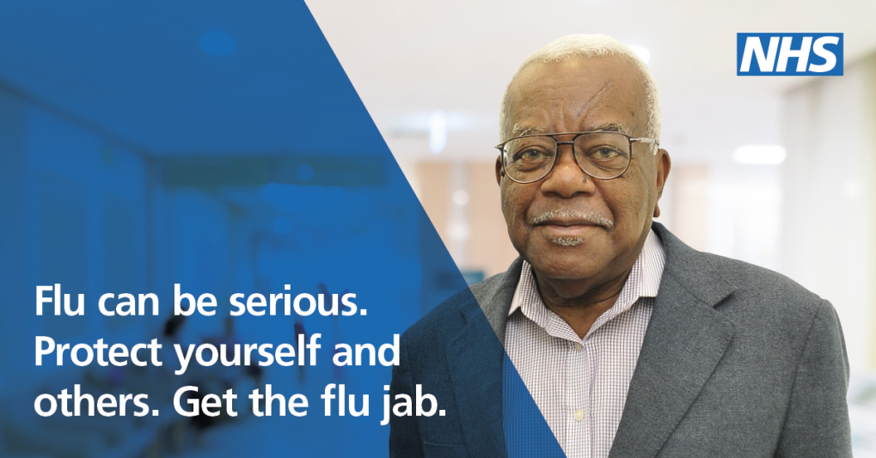

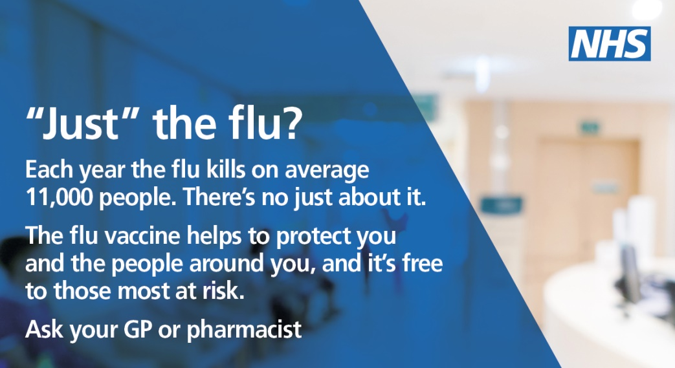
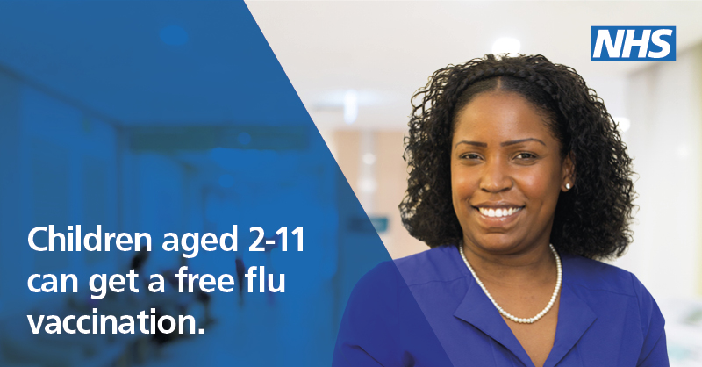
***Look out for our campaign across NW London***

Slide 13
Have you had your jab? Tell others also at risk…

Slide 14

Need more information?
  Download campaign resources and translations in 13 other languages visit nwlondonccgs.nhs.uk
  Information on the vaccine visit nhs.uk/conditions/flu
  Find out if your local pharmacy is offering the jab visit https://myvaccinations.co.uk/ or for Boots pharmacies www.boots.com/online/pharmacy-services/

